Slide 1
Sneaker Classification Meeting 3
By: Shahan Rahman, Hasibul Islam, Jun Zheng & Carlos Vides
Notes:
Begin development and load data into python script.
Finalize on sneaker catalog and have all images needed.
Decided how big should our database should be
Everyone individual roles starts which will result in every person having a slide that represents there progress with their roles.
Compare result of Connor project with replacing our data

Slide 2
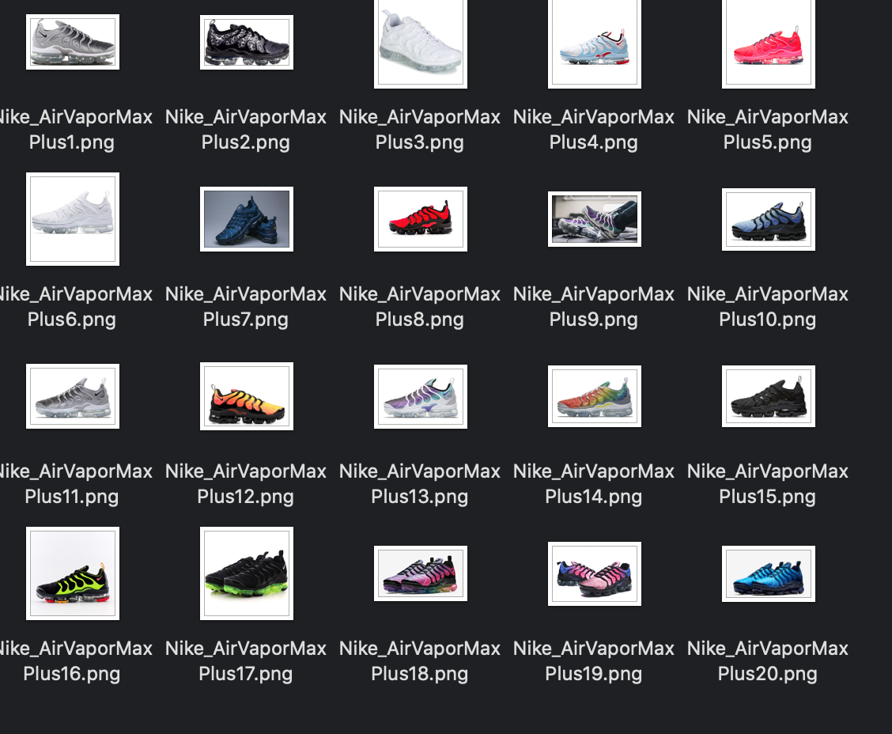
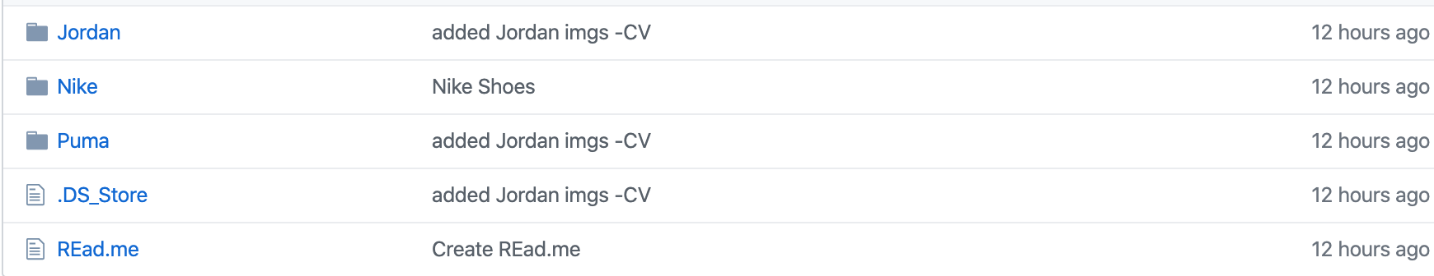
Our data
Each member of the group collected 20 images for each shoe in their respective company. In total each person collected 60 unique images. This comes out to a 240 image data set with 192 images being training data and 48 being test data.
Notes:
This came with alot of issues making sure images were png and making sure people

Slide 3
Shahan’s Work
Shahan Rahman - Project Manager & Full Stack Engineer
Setup environments to save and retrieve data (Github, Google Colab, Google Drive)
Planning milestones that we need to meet every week
Modifying Connors Project
Gathering data for Nike
Notes:
Open up a github workflow environment for the team

Slide 4
Hasib Work
Hasibul Islam - Frontend Engineer & QA Tester
Decide on User interface
Gathered data on Puma
Create unit test for individual components of machine algorithm.
Notes:
Decide whether it would be a mobile or a web application
platform of choice

Slide 5
Jun Work
Jun Zheng - Backend Engineer
Gathered data on Adidas
Rework Connor Project
Looking for new algorithms
Notes:
Decide whether it would be a mobile or a web application
platform of choice

Slide 6
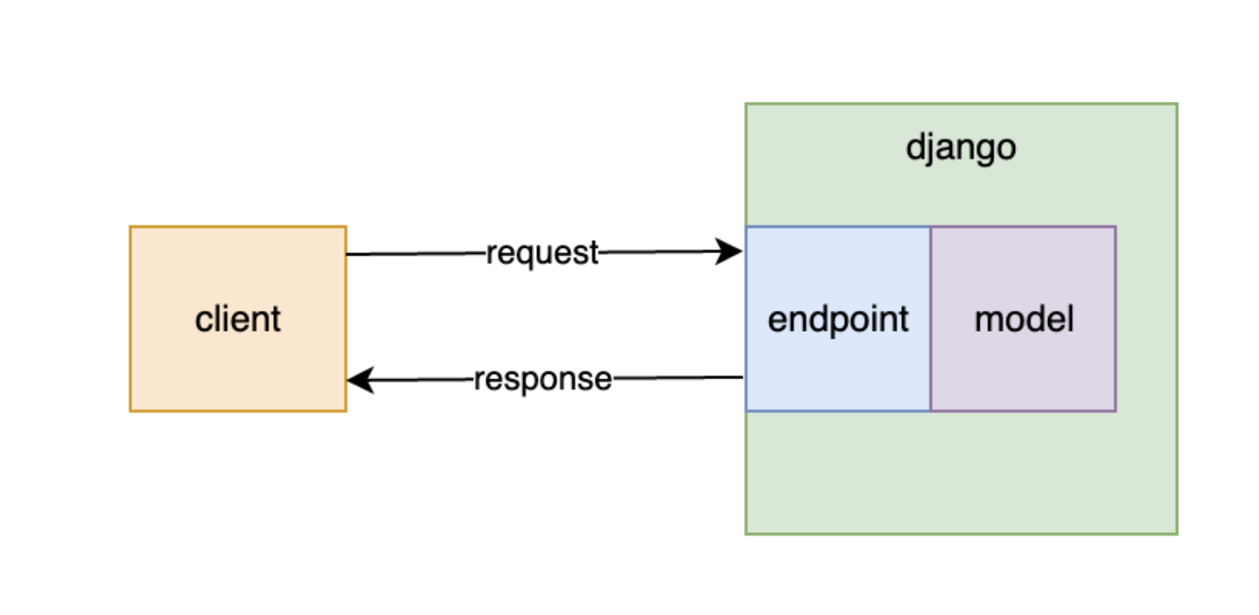
Carlos Work
Carlos Vides - Backend Engineer & QA Tester
Currently Learning Python3
Will use Django Backend Framework API
We’ll make a Django API that loads and runs a trained machine learning mode classifying sneakers

Slide 7
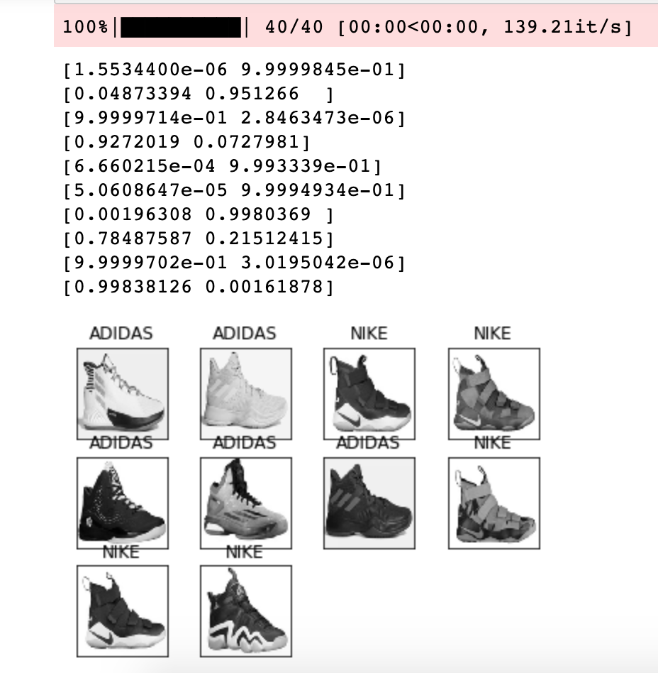
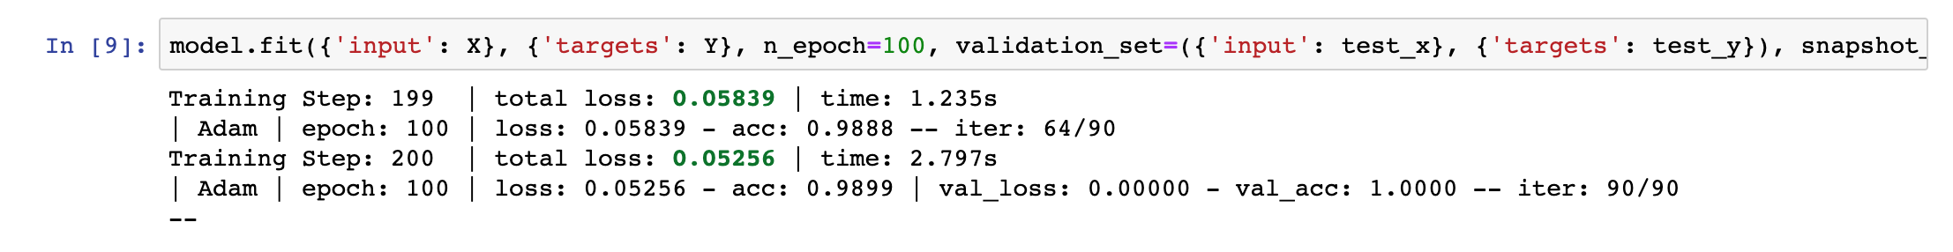
Connors Results For Project
Our group ran Connors project to recreate his results but got mixed numbers. In Connors article, he averages 92-93% accuracy but once our group runs his model we get different percentages ranging from 80-99%. But our opinion on his why his project is flawed is because he uses stock images and with a low data set to test with.
Notes:
This is the code that we use to actually fit the model. I am still having some trouble loading tensorboard to visualize the updating of parameters. However, this console output is still very interesting as you can experiment with your model parameters such as the size of the images, amount of training data, convolutional layers, convolutional kernel dimensions, and the number of epochs. According to this evaluation we have about 92–93% accuracy, which I was very happy with.

Slide 8
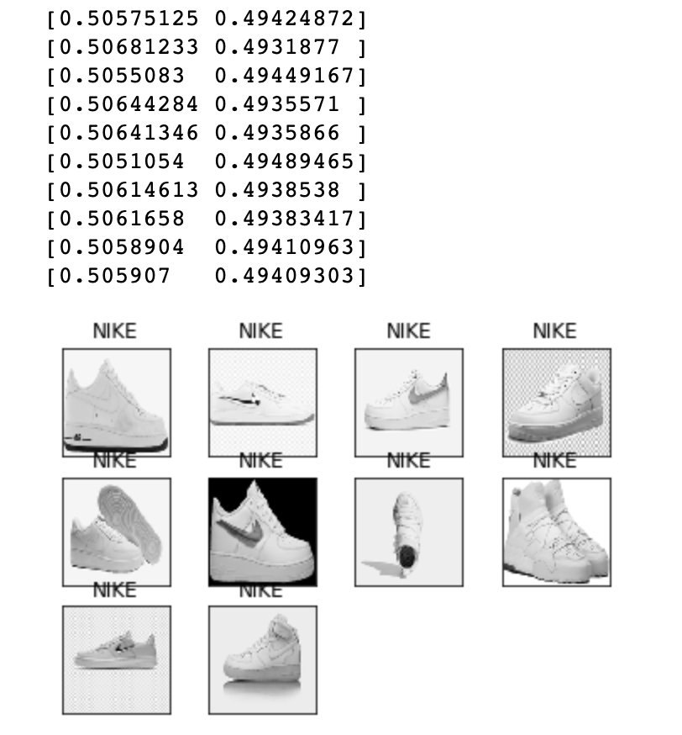
Our Results For Project
The results for our data shows a 49-50% accuracy. Since our data consist of non stock images we learned that this model is only efficient when you have still white background images. This means we need to tailor an image classification to adjust to different environments.
Notes:
Sort out the workload between all 4 members

Slide 9
What we plan to do between today and next meeting?
Work on our version our script
Compare results
Complete Individual work

Slide 10
Thank YOU!

